Slide 1
Comp 490/L
Senior Design Project
Fall 2022
Project Proposal
Group Name: MAAKDE
Team Leader: Kennedy Johnson

Slide 2
Team Members
Deni Cabaravdic (Backend)
Erik Vardumyan (Backend)
Kennedy Johnson (Lead) (Backend)
Aaron Madrid (Frontend)
Andres Macias (Frontend)
Matthew Kim (Frontend)
(We’re essentially all doing everything)

Slide 3
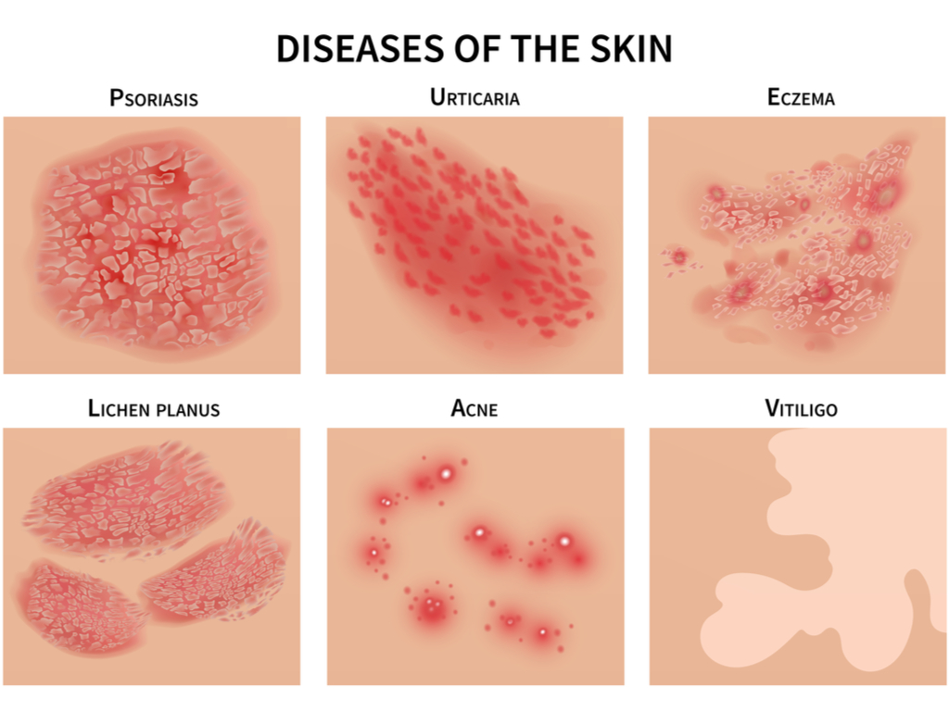
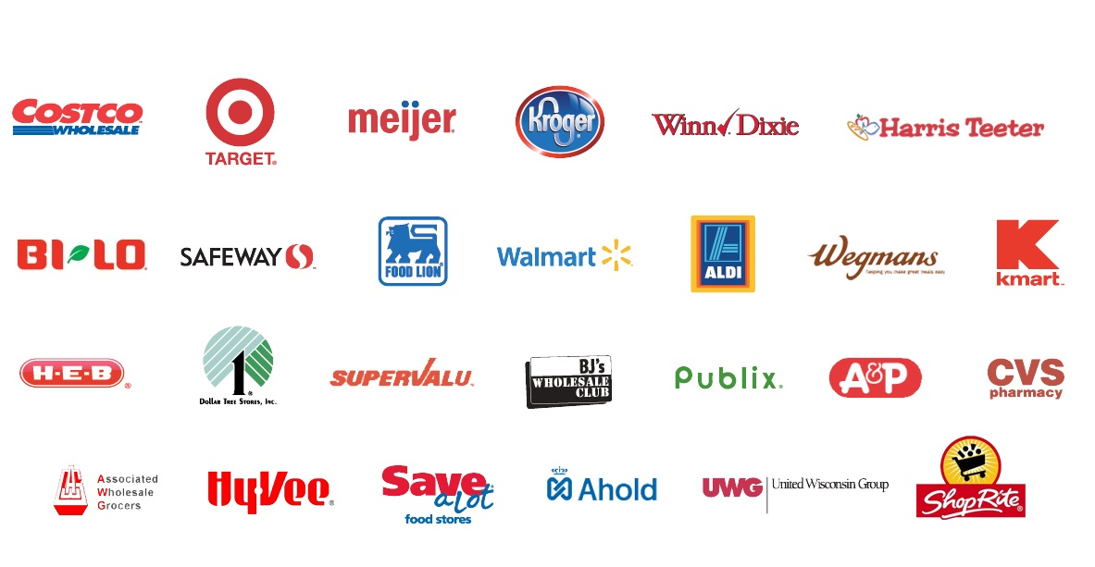
Background Section
Main focuses: We knew that we wanted to work with ML/DP and work with the machine learning model
First ideas:
Skin condition Tracker
The tracker could take an image of a skin condition and have the machine learning model teach them what it is and potentially diagnose them and more..
The program would have had the capabilities of recording data and utilize some form of AI to suggest all possible skin issues and provide documentation to present to healthcare providers
Review App using a barcode scanner
We looked to use image recognition to take a picture of a products/places barcode and gather reviews and all data. The program would not only use a single reviewing platform but, scrape the web for ALL forms of reviews and eventually output possible product alternatives and best priced purchasing sites.

Slide 4
Final Idea
We decided that we would develop a website that would give recommendations to users about their clothing apparel and fashion.
The user would take a picture of a piece of their clothing, and our machine learning model would give recommendations to pair with other pieces of clothing based off color theory/style preferences.
The clothing recommendations would also give users a list of retailers to find the most affordable options.

Slide 5
Project Summary
What is the project about?
We decided that we would develop a website that would give recommendations to users about their clothing apparel and fashion.
What are the GOALS of the project?
Have the website that can successfully use ML to give plausible recommendations for varied outfits the user inputs to the website.
A working interface that the user can use and interact with
We hope to have the ML set up and moderately functioning by the end of the semester.

Slide 6
Project Importance
Next essential app/browser bookmark
Encourage and Help improve User’s Fashion
Incorporate ML and image recognition into the fashion industry
Broader impact(s) of our project

Slide 7
Target Audience
We believe our service would appeal to the younger generation, specifically Gen Z. Our service may also appeal to users who want to get into fashion but do not know where to start.

Slide 8
Project Approach
Strategy :
Use Blender to create models of fashion choices, use color theory and develop queries to compile possible combinations for fashion choices.
Methodology :
Go through documentation/research to plan the development life cycle of our application.
Open source/3rd Party Software:
Machine Learning/Image Recognition Libraries, React.js, SQL, Node.js, Express.js, openCV, (potentially) Tensorflow/Keras

Slide 9
Questions?

